Slide 1




Operating Systems:
Internals and Design Principles
Chapter 2 Operating System
Overview
Eighth Edition By William Stallings

Slide 2



Operating System
A program that controls the execution of application programs
An interface between applications and hardware
Main objectives of an OS:
convenience
efficiency
ability to evolve

Slide 3


Application programming interface
Application binary interface
Application programs
Libraries/utilities
Software
Operating system
Instruction Set Architecture
Execution hardware
System interconnect (bus)
Memory translation
Hardware
I/O devices and networking
Main memory
Figure 2.1 Computer Hardware and Software Structure

Slide 4

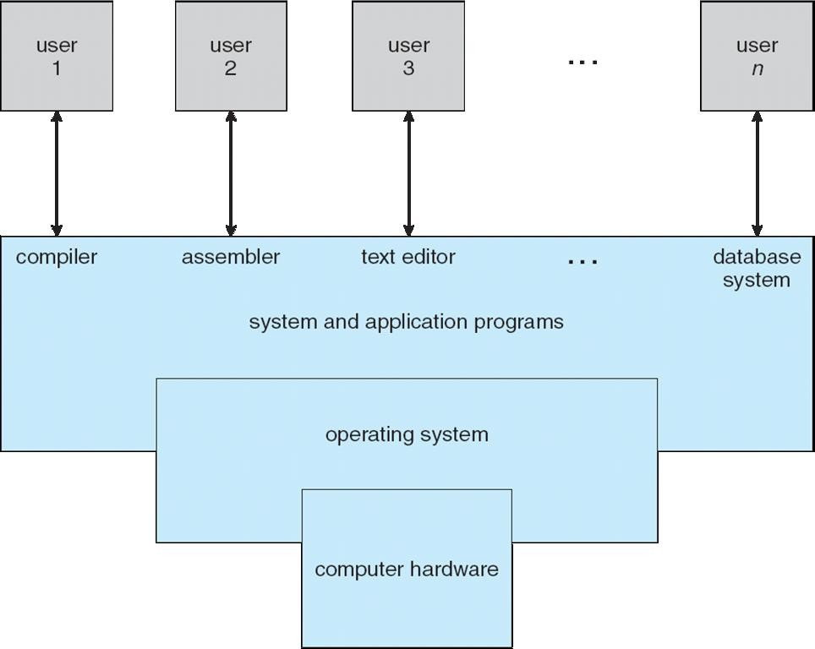
Computer System Structure
Computer system can be divided into four components:
Hardware : provides basic computing resources CPU, memory, I/O devices
Operating system:
Controls and coordinates use of hardware among various applications and users
Application programs : define the ways in which the system
resources are used to solve the computing problems of the users
Word processors, compilers, web browsers, database systems, video games
Users:
People, machines, other computers
12/1/2020

Slide 5


Operating System Services
Program development
Program execution
Access I/O devices
Controlled access to files
System access
Error detection and response
Accounting
(read in detail from book)

Slide 6


Key Interfaces
Instruction set architecture (ISA)
Application binary interface (ABI)
Application programming interface (API)

Slide 7


The Role of an OS
A computer is a set of resources for the movement, storage, and processing of data
The OS is responsible for managing these resources

Slide 8


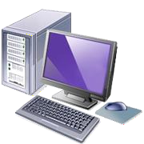

Operating System as Software
Functions in the same way as ordinary computer software
Program, or suite of programs, executed by the processor
Frequently relinquishes control and must depend on the processor to allow it to regain control

Slide 9


Computer System
Memory
I/O Devices
Operating System Software
I/O Controller
Printers,
keyboards, digital camera, etc.
I/O Controller
Programs and Data
I/O Controller
Processor
Processor
Storage
OS
Programs
Data
Figure 2.2
The Operating System as Resource Manager

Slide 10









Evolution of Operating Systems
A major OS will evolve over time for a number of reasons:
hardware upgrades
new types of hardware
new services
Fixes

Slide 11







Evolution of Operating Systems
Stages include:
Time Sharing Systems
Multiprogrammed Batch Systems
Simple Batch Systems
Serial Processing

Slide 12

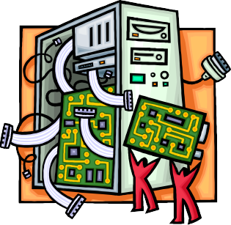

Serial Processing
Earliest Computers:
No operating system
programmers interacted directly with the computer hardware
Computers ran from a console with display lights, toggle switches, some form of input device, and a printer
Users have access to the computer in “series”
Problems:
Scheduling:
most installations used a hardcopy sign-up sheet to reserve computer time
time allocations could run short or long, resulting in wasted computer time
Setup time
a considerable amount of time was spent just on setting up the program to run

Slide 13


Simple Batch Systems
Early computers were very expensive
important to maximize processor utilization
Monitor
user no longer has direct access to processor
job is submitted to computer operator who batches them together and places them on an input device
program branches back to the monitor when finished

Slide 14


Monitor Point of View
Interrupt Processing
Device Drivers
Job Sequencing
Control Language Interpreter
User Program Area
Monitor controls the sequence of events
Monitor
Resident Monitor is software always in memory
Monitor reads in job and gives control
Job returns control to monitor
Boundary
Figure 2.3
Memory Layout for a Resident Monitor

Slide 15


Processor Point of View
Processor executes instruction from the memory containing the monitor
Executes the instructions in the user program until it encounters an ending or error condition
“control is passed to a job” means processor is fetching and executing instructions in a user program
“control is returned to the monitor” means that the processor is fetching and executing instructions from the monitor program

Slide 16




Desirable Hardware Features
Memory protection for monitor
while the user program is executing, it must not alter the memory area containing the monitor
Timer
prevents a job from monopolizing the system
Privileged instructions
can only be executed by the monitor
Interrupts
gives OS more flexibility in controlling user programs

Slide 17



Modes of Operation
User Mode
user program executes in user mode
certain areas of memory are
protected from user access
certain instructions may not be executed
Kernel Mode
monitor executes in kernel mode
privileged instructions may
be executed
protected areas of memory may be accessed

Slide 18




Simple Batch System Overhead
Processor time alternates between execution of user programs and execution of the monitor
Sacrifices:
some main memory is now given over to the monitor
some processor time is consumed by the monitor
Despite overhead, the simple batch system improves utilization of the computer

Slide 19



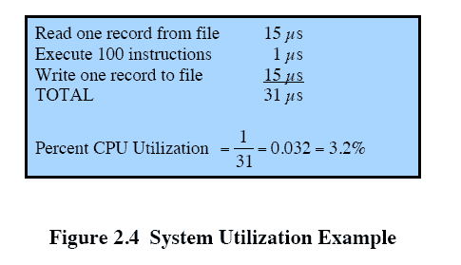
Multiprogrammed Batch Systems
Processor is often idle
even with automatic job sequencing
I/O devices are slow compared to processor

Slide 20


Uniprogramming
Run | Wait | Run | Wait
Program A
Time
(a) Uniprogramming
The processor spends a certain amount of time executing, until it reaches an I/O instruction; it must then wait until that I/O instruction concludes before proceeding

Slide 21


Multiprogramming
Run | Wait | Run | Wait
Program A
Program B Combined
Time
(b) Multiprogramming with two programs
There must be enough memory to hold the OS (resident
monitor) and one user program
When one job needs to wait for I/O, the processor can switch to the other job, which is likely not waiting for I/O
Wait | Run | Wait | Run | Wait
Run A | Run B | Wait | Run A | Run B | Wait

Slide 22

Multiprogramming
Run | Wait | Run | Wait
Program A
Program B Program C Combined
Time
(c) Multiprogramming with three programs
Wait | Run | Wait | Run | Wait
Wait | Run | Wait | Run | Wait
Run | Run | Run | Wait | Run | Run | Run | Wait
A | B | C |  | A | B | C
Multiprogramming
also known as multitasking
memory is expanded to hold three, four, or more programs and switch among all of them

Slide 23



Multiprogramming Example
JOB1
JOB2
JOB3
Type of job | Heavy compute | Heavy I/O | Heavy I/O
Duration | 5 min 50 M No No No | 15 min 100 M No Yes No | 10 min 75 M Yes No Yes
Memory required Need disk?
Need terminal?
Need printer?
Table 2.1
Sample Program Execution Attributes

Slide 24



Effects on Resource Utilization
Uniprogramming
Multiprogramming
Processor use | 20% | 40%
Memory use | 33% | 67%
Disk use | 33% | 67%
Printer use | 33% | 67%
Elapsed time | 30 min | 15 min
Throughput | 6 jobs/hr | 12 jobs/hr
Mean response time | 18 min | 10 min
Table 2.2
Effects of Multiprogramming on Resource Utilization

Slide 25


100%
100%
CPU
CPU
0%
0%
100%
100%
Memory
Memory
0%
0%
100%
100%
Disk
Disk
0%
0%
100%
100%
Terminal
Terminal
0%
0%
100%
100%
Printer
Printer
0%
0%
Job History
JOB1
JOB2
JOB3
Job History
JOB1
0
5
10
15
minutes
20
25
30
JOB2
JOB3
time
0
5
10
minutes
15
time
(a) Uniprogramming
(b) Multiprogramming
Figure 2.6 Utilization Histograms

Slide 26




Time-Sharing Systems
Can be used to handle multiple interactive jobs
Processor time is shared among multiple users
Multiple users simultaneously access the system through terminals, with the OS interleaving the execution of each user program in a short burst or quantum of computation

Slide 27



Batch Multiprogramming vs. Time Sharing
 | Batch Multiprogramming | Time Sharing
Principal objective | Maximize processor use | Minimize response time
Source of directives to operating system | Job control language commands provided with the job | Commands entered at the terminal
Table 2.3
Batch Multiprogramming versus Time Sharing

Slide 28





Compatible Time-Sharing Systems
CTSS
One of the first time-sharing
operating systems
Developed at MIT by a group known as Project MAC
Ran on a computer with 32,000 36-bit words of main memory, with the resident monitor consuming 5000 of that
To simplify both the monitor and memory management a program was always loaded to start at the location of the 5000th word
Time Slicing
System clock generates interrupts at
a rate of approximately one every
0.2 seconds
At each interrupt OS regained control and could assign processor to another user
At regular time intervals the current user would be preempted and another user loaded in
Old user programs and data were
written out to disk
Old user program code and data were restored in main memory when that program was next given a turn

Slide 29


0
0
0
 | Monitor | 5000 | Monitor | 5000 | Monitor
 |  |  |  |  | JOB 3
 | JOB 1 |  | JOB 2 | 10000
 |  |  |  |  | (JOB 2)
 | Free | 25000 |  | 25000
 |  |  | Free |  | Free
5000
20000
32000
32000
32000
(a)
(b)
(c)
0
5000
0
5000
0
5000
Monitor
JOB 1
(JOB 2)
Free
Monitor
JOB 4
(JOB 1)
(JOB 2)
Free
Monitor
JOB 2
Free
15000
20000
25000
20000
25000
25000
32000
32000
32000
(d)
(e)
(f)
Figure 2.7 CTSS Operation

Slide 30




Major Achievements
Operating Systems are among the most complex pieces of software ever developed
Major advances in development include:
processes
memory management
information protection and security
scheduling and resource management
system structure

Slide 31



Process
Fundamental to the structure of operating systems
A process can be defined as:
a program in execution
an instance of a running program
the entity that can be assigned to, and executed on, a processor
a unit of activity characterized by a single sequential thread of execution, a current state, and an associated set of system resources

Slide 32



Development of the Process
Three major lines of computer system development created problems in timing and synchronization that contributed to the development:
multiprogramming batch operation
processor is switched among the various programs residing in main memory
time sharing
be responsive to the individual user but be able to support many users simultaneously
real-time transaction systems
a number of users are entering queries or updates against a database

Slide 33



Causes of Errors
Improper synchronization
a program must wait until the data are available in a buffer
improper design of the signaling mechanism can result in loss or duplication
Failed mutual exclusion
more than one user or program attempts to make use of a shared resource at the same time
only one routine at a time allowed to perform an update against the file
Nondeterminate program operation
program execution is interleaved by the processor when memory is shared
the order in which programs are scheduled may affect their outcome
Deadlocks
it is possible for two or more programs to be hung up waiting for each other
may depend on the chance timing of resource allocation and release

Slide 34



Components of a Process
A process contains three components:
an executable program
the associated data needed by the program (variables, work space, buffers, etc.)
the execution context (or “process state”) of the program
The execution context is essential:
it is the internal data by which the OS is able to supervise and control the process
includes the contents of the various process registers
includes information such as the priority of the process and whether the process is waiting for the completion of a particular I/O event

Slide 35
Main Memory
Processor Registers
Process index
i
Process Management
i
PC
Process list
Base Limit
b
j
h
Other registers
Context
The entire state of the process at any instant is contained in its context
New features can be designed and incorporated into the OS by expanding the context to include any new information needed to
Process A
Data
Program (code)
b
Context
Process B
h
Data
Program (code)
support the feature
Figure 2.8
Typical Process Implementation

Slide 36




Memory Management
The OS has five principal storage management responsibilities:
automatic allocation and management
support of modular programming
protection and access control
process isolation
long-term storage

Slide 37




Information Protection and Security
The nature of the threat that concerns
an organization will vary greatly depending on the circumstances
The problem involves controlling access to computer systems and the information stored in them
Main issues
availability
authenticity
confidentiality
data integrity

Slide 38




Scheduling and Resource Management
Key responsibility of an OS is managing resources
fairness
efficiency
Resource allocation policies must consider:
differential
responsiveness

Slide 39


Operating System
Service Call from Process
Service Call
Handler (code)
Interrupt
Long-
Short- I/O
from Process
Interrupt from I/O
Interrupt Handler (code)
Term Queue
Term Queue
Queues
Short-Term Scheduler (code)
Pass Control to Process
Figure 2.11 Key Elements of an Operating System for Multiprogramming

Slide 40




Different Architectural Approaches
Demands on operating systems require new ways of organizing the OS
Different approaches and design elements have been tried:
microkernel architecture
multithreading
symmetric multiprocessing
distributed operating systems
object-oriented design

Slide 41




Microkernel Architecture
Assigns only a few essential functions to the kernel:
interprocess
address spaces
communication (IPC)
basic scheduling
The approach:
simplifies implementation
provides flexibility
is well suited to a distributed environment

Slide 42


Multithreading
Technique in which a process, executing an application, is divided into threads that can run concurrently
Thread
dispatchable unit of work
includes a processor context and its own data area to enable subroutine branching
executes sequentially and is interruptible
Process
a collection of one or more threads and associated system resources
programmer has greater control over the modularity of the application and the timing of application related events

Slide 43




Multicore OS Considerations
The design challenge for a many-core multicore system is to efficiently harness the multicore processing power and intelligently manage the substantial on-chip resources efficiently
Potential for parallelism exists
at three levels:
hardware parallelism within each core processor, known as instruction level parallelism
potential for multiprogramming and multithreaded execution within each processor
potential for a single application to execute in concurrent processes or threads across multiple cores

Slide 44


Client/Server Model
Windows OS services, environmental subsystems, and applications are all structured using the client/server model
Common in distributed systems, but can be used internal to a single system
Processes communicate via RPC
Advantages:
it simplifies the Executive
it improves reliability
it provides a uniform means for applications to communicate with services via RPCs without restricting flexibility
it provides a suitable base
for distributed computing

Slide 45

Traditional UNIX Systems
Were developed at Bell Labs and became operational on a PDP-7 in 1970
Incorporated many ideas from Multics
PDP-11was a milestone because it first showed that UNIX would be an OS for all computers
Next milestone was rewriting UNIX in the programming language C
demonstrated the advantages of using a high-level language for system code
Was described in a technical journal for the first time in 1974
First widely available version outside Bell Labs was Version 6 in 1976
Version 7, released in 1978 is the ancestor of most modern UNIX systems
Most important of the non-AT&T systems was UNIX BSD (Berkeley Software Distribution)

Slide 46



UNIX Commands and Libraries
System Call Interface
Kernel
Hardware
User-written Applications
Figure 2.15 General UNIX Architecture

Slide 47


User Programs
Trap
User Level Kernel Level
Libraries
System Call Interface
File Subsystem
Inter-process communication
Process Control
Scheduler
Subsystem
Buffer Cache
Memory management
character
block
Device Drivers
Hardware Control
Kernel Level
Hardware Level
Hardware
Figure 2.16 Traditional UNIX Kernel

Slide 48


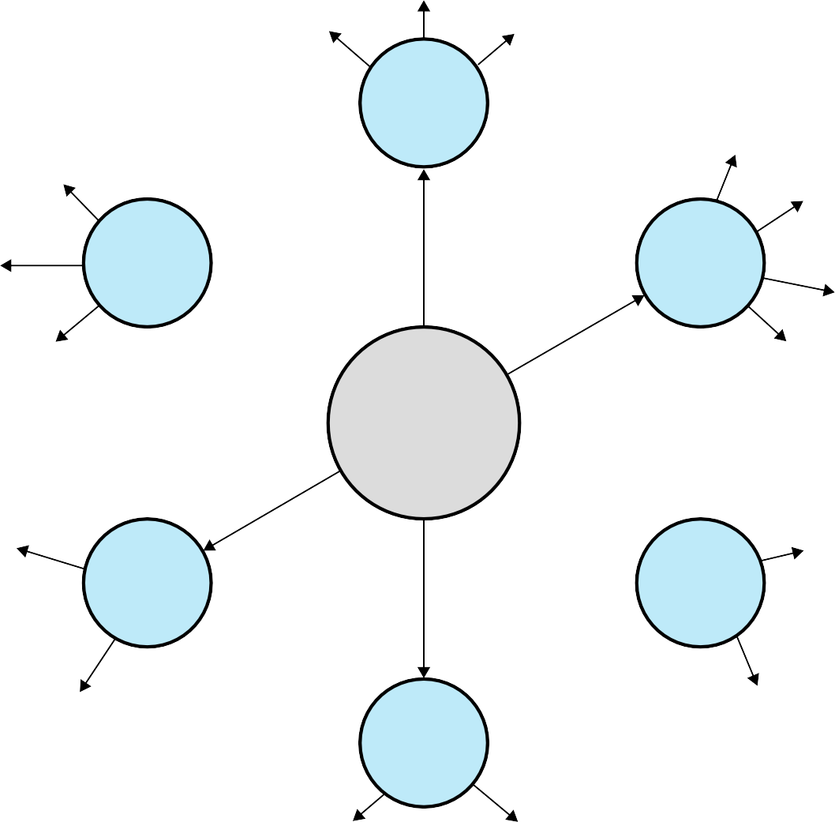
coff
a.out
elf
exec switch
NFS
file mappings
FFS
device mappings
virtual memory framework
vnode/vfs interface
s5fs
anonymous mappings
RFS
Common Facilities
disk driver
block device switch
time-sharing processes
scheduler framework
tape driver
system processes
STREAMS
network driver
tty driver
Figure 2.17
Modern UNIX Kernel [VAHA96]

Slide 49



Modular Monolithic Kernel
Loadable Modules
Includes virtually all of the OS functionality in one large block of code that runs as a single process with a single address space
All the functional components of the kernel have access to all of its internal data structures and routines
Linux is structured as a collection of modules
Relatively independent blocks
A module is an object file whose code can be linked to and unlinked from the kernel at runtime
A module is executed in kernel mode on behalf of the current process
Have two important
characteristics:
dynamic linking
stackable modules

Slide 50


module
module
*next
*next
*name
*name
size
size
usecount
usecount
flags
flags
nysms
nysms
ndeps
FAT
ndeps
VFAT
*syms
*syms
*deps
*deps
*refs
*refs
kernel_symbol
symbol_table
value
value
*name
value
*name
value
*name
*name
value
*name
value
*name
Figure 2.18 Example List of Linux Kernel Modules

Slide 51




processes
user level
signals
system calls
processes
& scheduler
file systems
network protocols
virtual memory
kernel
char device drivers
block device drivers
network de- vice drivers
traps & faults
physical memory
interrupts
hardware
CPU
system memory
terminal
disk
network inter- face controller
Figure 2.19 Linux Kernel Components

Slide 52


Linux Signals
SIGHUP | Terminal hangup | SIGCONT | Continue
SIGQUIT | Keyboard quit | SIGTSTP | Keyboard stop
SIGTRAP | Trace trap | SIGTTOU | Terminal write
SIGBUS | Bus error | SIGXCPU | CPU limit exceeded
SIGKILL | Kill signal | SIGVTALRM | Virtual alarm clock
SIGSEGV | Segmentation violation | SIGWINCH | Window size unchanged
SIGPIPT | Broken pipe | SIGPWR | Power failure
SIGTERM | Termination | SIGRTMIN | First real-time signal
SIGCHLD | Child status unchanged | SIGRTMAX | Last real-time signal
Table 2.6
Some Linux Signals

Slide 53


Filesystem related
close link open read write
Close a file descriptor. Make a new name for a file.
Open and possibly create a file or device. Read from file descriptor.
Write to file descriptor
Process related
execve exit getpid setuid
Execute program.
Terminate the calling process.
Get process identification.
Set user identity of the current process.
ptrace
Provides a means by which a parent process my observe and control the execution of another process, and examine and change its core image and registers.
Scheduling related
sched_getparam
Sets the scheduling parameters associated with the scheduling policy for the process identified by pid.
sched_get_priority_max Returns the maximum priority value that can be used with the
scheduling algorithm identified by policy.
sched_setscheduler
Sets both the scheduling policy (e.g., FIFO) and the associated parameters for the process pid.
Writes into the timespec structure pointed to by the parameter tp the round robin time quantum for the process pid.
A process can relinquish the processor voluntarily without blocking via this system call. The process will then be moved to the end of the queue for its static priority and a new process gets to run.
sched_rr_get_interval
sched_yield
Table 2.7
Some Linux System Calls (page 1 of 2)

Slide 54

Interprocess Communication (IPC) related
msgrcv
A message buffer structure is allocated to receive a
message. The system call then reads a message from the message queue specified by msqid into the newly created message buffer.
Performs the control operation specified by cmd on the semaphore set semid.
Performs operations on selected members of the semaphore set semid.
Attaches the shared memory segment identified by shmid to the data segment of the calling process.
Allows the user to receive information on a shared memory segment, set the owner, group, and permissions of a shared memory segment, or destroy a segment.
semctl
semop
shmat
shmctl
Socket (networking) related
bind
Assigns the local IP address and port for a socket. Returns 0 for success and –1 for error.
Establishes a connection between the given socket and the remote socket associated with sockaddr.
Returns local host name.
Send the bytes contained in buffer pointed to by *msg over the given socket.
Sets the options on a socket
connect
gethostname send
setsockopt
Miscellaneous
fsync
Copies all in-core parts of a file to disk, and waits until the device reports that all parts are on stable storage.
Returns the time in seconds since January 1, 1970.
Simulates a hangup on the current terminal. This call arranges for other users to have a "clean" tty at login time.
time vhangup
Table 2.7
Some Linux System Calls (page 2 of 2)

